Slide 1
Liner Programming
Solution using scipy.optimization.linprog

Slide 2
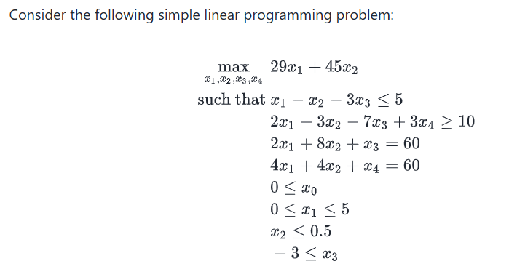

Slide 3


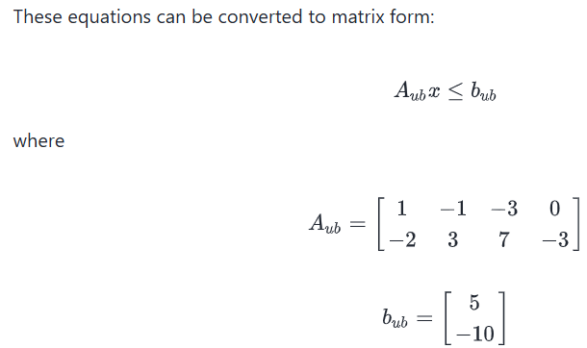


Slide 4
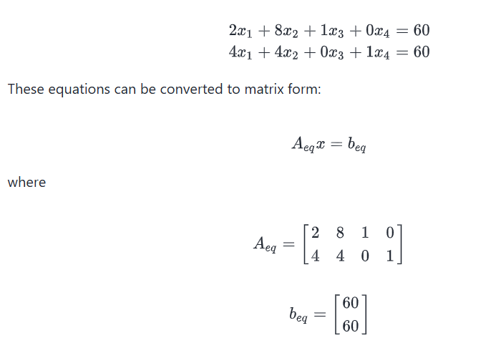

Slide 5


